Slide 1
Differentiator circuit
Ali Jawad
Robotics and Embedded Systems, University of Advancing Technology
RBT125: Introduction to Robotics
Instructor: Matt Prater

Slide 2


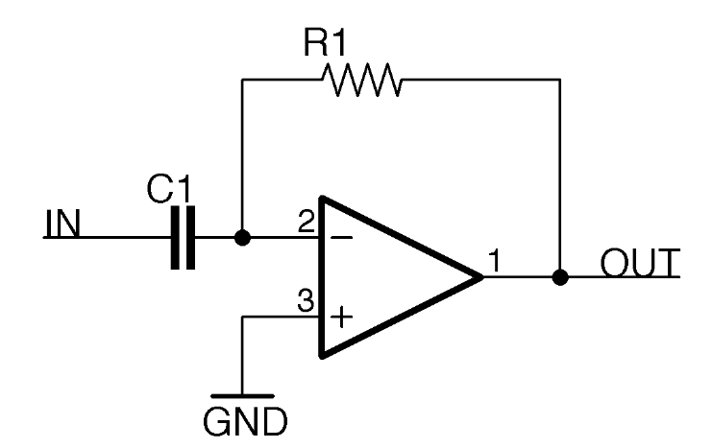
Function
Differentiation Op-Amp:
Amplifier Circuit.
Opposite of Integrator Circuit.
Notes:
Differential Operational Amplifier: its simply used the inverter gate to inverse the Vout proportional to the rate of change of the applied input voltage. The circuit mathematics is very simple and can be calculated by using series circuit I equation:
Itot = Ic = Iout
C * (d Vin-0 / dt) = d0-Vout / R
Simplify
Vout = - RC dVin / dt
From studying calculus the differentiation is measuring the rate of changes. So basically this circuit is working by take the input ad measure the variation and change on the input. So if Vin is constant the Vout will equal zero because there is no changes.
From the minus signal on the derivative equation means the Vout will be inverted and the opposite direction of the Vin and how the circuit works by taking the variation in Vin and create an amplified, inverted and opposite direction Vout.

Slide 3


Circuit uses
High Pass Filter
Wave-Shaping
Analogue PID Controlers
Analogue Computers
Notes:
From studying the op amp differential circuit applications the circuit is very important as high pass filter it also can generate an square wave from a triangle wave also the if the voltage input is a sine wave the output voltage will be cosine wave that the circuit will be beneficial in invert opposite direction applications. The circuit used in the analogue PID's and analogue computers. As the circuit is an amplifier and produces a constant output voltage for a steadily changing input voltage which is the opposite of the integrator circuit which produce a steadily changing output voltage for a constant input voltage. As the resistor in the circuit forms a negative feedback element across the invertor that allow the delay in the capacitance to change the output wave and will act as amplifier.

Slide 4
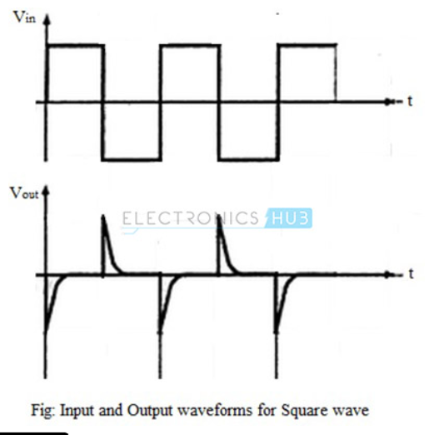
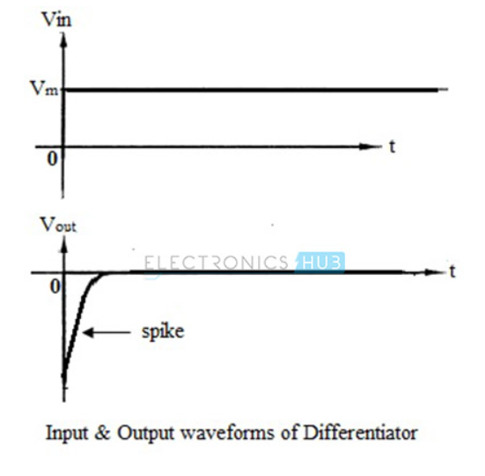
Advantages
Simple construction.
Low cost.
Easy to design.
Small size.
Notes:
The product Cx Rx is called the RC time constant of the differentiator circuit. The negative sign indicates the output is out of phase by 1800 with respect to the input. The main advantage of such an active differentiating amplifier circuit is the small-time constant required for differentiation.
The other advantage of the differentiator circuit outputs the derivative of the input signal over a frequency range based on the circuit time constant and the bandwidth of the amplifier. The input signal is applied to the inverting input so the output is inverted relative to the polarity of the input signal. Another advantage of such ideal differentiator is the small time constant required for differentiation.
Also the effective resistance becomes very very small and the condition RC smaller that T gets satisfied for all frequencies.

Slide 5
Disadvantages
Frequency
Impedence
Oscillations
Notes:
Disadvantages of Ideal Differentiator:
The gain of the differentiator increases as frequency increases. Thus at some high frequency, the differentiator may become unstable and break into oscillations. There is a possibility that Op-amp may go into saturation.
Also, the input impedance decreases as frequency increases. This makes circuit very much sensitive to the noise.
Hence the differentiator circuit suffers from the limitations on its stability and noise problems at high frequencies.
Distortion is introduced in the output.
Operation is highly dependent on frequency of input signal.
Gain is less than 1 i.e. signal gets attenuated.
For proper operation, the time constant has to be small.

Slide 6

Variations of Op-amp circuit
Notes:
The product Cx Rx is called the RC time constant of the differentiator circuit. The negative sign indicates the output is out of phase by 1800 with respect to the input. The main advantage of such an active differentiating amplifier circuit is the small-time constant required for differentiation.
The other advantage of the differentiator circuit outputs the derivative of the input signal over a frequency range based on the circuit time constant and the bandwidth of the amplifier. The input signal is applied to the inverting input so the output is inverted relative to the polarity of the input signal.

Slide 7
references
Teja, R. (2023, March 13). Operational amplifier as differentiator. ElectronicsHub. https://www.electronicshub.org/operational-amplifier-as-differentiator/
YouTube. (2022). YouTube. Retrieved October 8, 2023, from https://www.youtube.com/watch?v=P5rrkTI3hZw.
YouTube. (2019). YouTube. Retrieved October 8, 2023, from https://www.youtube.com/watch?v=idJEMYhrIfs.

